Slide 1
ANTERIOR AND POSTERIOR COMPARTMENT OF ARM
BY
DR. OGWUCHE ELIJAH
(BSc. MSc. MBBS)
LAGOS STATE UNIVERSITY COLLEGE OF MEDICINE (LASUCOM),
IKEJA.

Slide 2
OUTLINE
INTRODUCTION
ANTERIOR COMPARTMENTS
POSTERIOR COMPARTMENTS
BLOOD VESSELS
NERVES
ACTIONS
CLINICAL RELEVANCE

Slide 3
INTRODUCTION
The ARM is the structural and functional part of the upper limb extending from the shoulder joint to the elbow joint
Consist of two compartments; anterior compartment and posterior compartment, separated by lateral and medial intermuscular septa
It is made up of four muscles; Biceps brachii, brachialis, coracobrachialis and triceps brachii
The bone of the arm is the humerus
There are also blood vessels and nerves that passes through and supply the structures of the arm

Slide 4
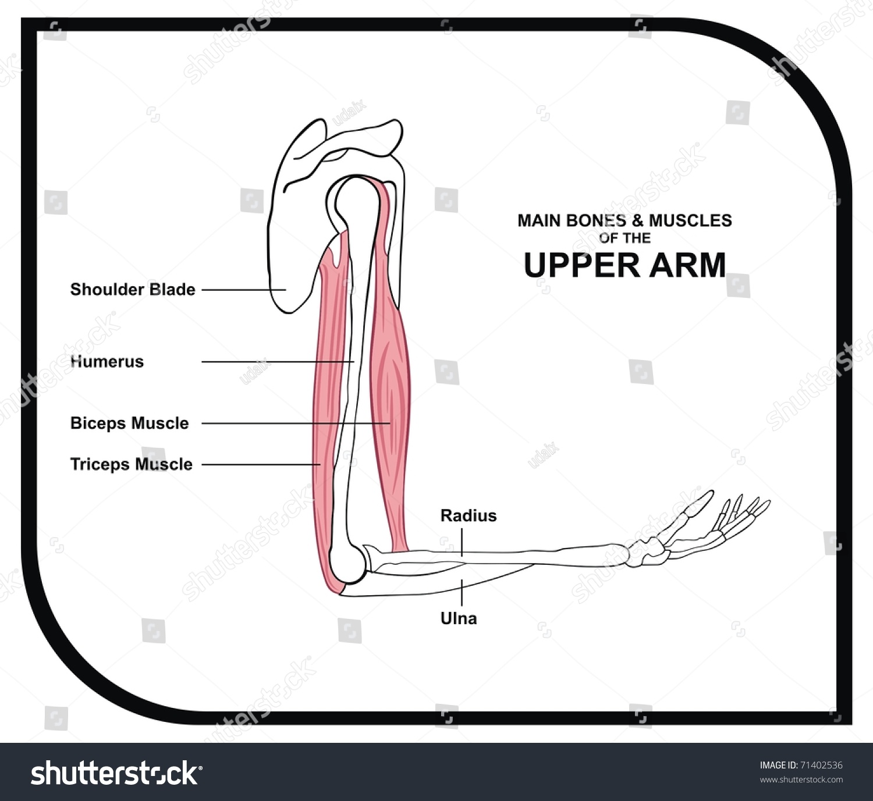
THE ARM

Slide 5
ANTERIOR COMPARTMENT
This is the flexor compartment of the arm
Made up of three muscles; Biceps brachii, brachialis and coracobrachialis

Slide 6
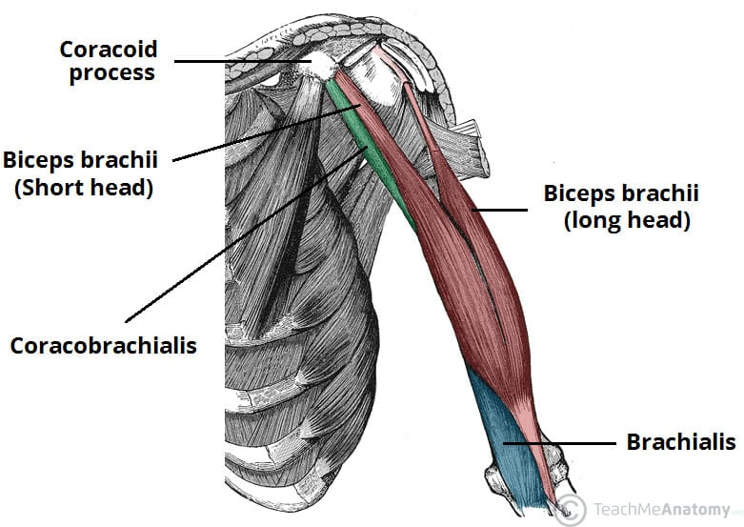
Muscles of anterior compartment of the arm

Slide 7
BICEPS BRACHII
BICEPS BRACHII; These has two heads ( the long head and short head)
ORIGIN;
. Long head; Intracapsular, originates from the supraglenoid tubercle of the scapula
. Short head; coracoid process of scapula, with conjoint origin of coracobrachialis
INSERTION; radial tuberosity and fascia of forearm via biciptal aponeurosis
BLOOD SUPPLY; Brachial artery
NERVE SUPPLY; Musculocutaneous nerve (C5, C6 & C7)
ACTION; Flexion of the arm and supination of forearm
CLINICAL; .Rupture of the biceps tendon produces a characteristic sign called “Popeye sign” on flexing the elbow
. Biceps tenotomy; a surgical procedure that involves dettachement of the biceps tendon at the origin to relieve persistent shoulder pain

Slide 8
BRACHIALIS
This is located distally in the arm and form the floor of cubital fossa
ORIGIN; Lower part of the anteromedial and anterolateral part of humeral shaft
.From the lower part of spiral groove
. From medial intermuscular septum
INSERTION; Ulnar tuberosity and coronoid process of ulnar
BLOOD SUPPLY; Brachial artery
NERVE SUPPL; Majorly by the musculocutaneous nerve, it also receive contribution from the radial nerve
ACTION; It flexes the elbow joint

Slide 9
CORACOBRACHIALIS
Located more proximally in the arm, pierced in the axilla by the musculocutaneous nerve
ORIGIN; Coracoid process of scapula. Have common origin with the short head of biceps brachii
INSERTION; medial side of humeral shaft at the level of deltoid tuberosity
BLOOD SUPPLY; Brachial artery
NERVE SUPPLY; musculocutaneous nerve
ACTION; Flexes the arm

Slide 10
POSTERIOR COMPARTMENT OF THE ARM
The posterior compartment of the arm is made up of majorly the triceps brachii. The anconeous is also located in the posterior compartment of the arm
Also called extensor compartment
The triceps brachii have three heads; the long head, medial head and lateral head

Slide 11
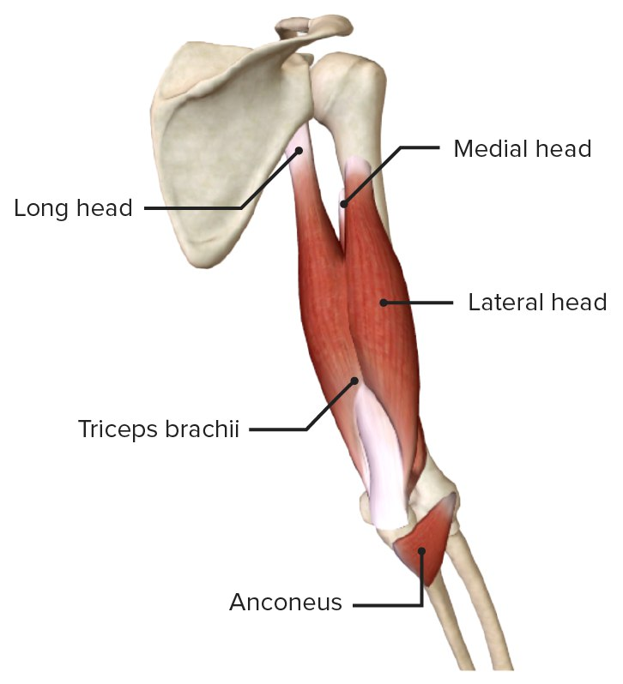
POSTERIOR COMPARTMENT

Slide 12
TRICEPS BRACHII
ORIGINS
Long head; originates from the infraglenoid tubercle of the scapula
Lateral head; originates superior to the radial groove of the humerus
Medial head; originates inferior to the radial groove of the humerus
INSERTION; Collectively the three heads converge into a common tendon and inserts on to the olecranon process of ulnar

Slide 13
TRICEPS BRACHII
BLOOD SUPPLY; Profunda brachii and ulnar collateral arteries
NERVE SUPPLY; Radial nerve
ACTION; Extension of the forearm at the elbow joint
STRUCTURES PASSING THROUGH; Radial nerve and ulnar nerve

Slide 14
CLINICAL SIGNIFICANCE
Biceps; Rupture of the biceps tendon leads to weakness of the muscle as it detach from the origin. With flexion of elbow, it gives a characteristic sign called “Popeye sign”
Biceps tenotomy is surgical detachment of biceps tendon to relieve persistent shoulder pain
Yergason’s test; supination and lateral rotation of the arm leading to pain or clicking sound in the bicipital groove suggest biceps pathology such as bicipital tendonitis.

Slide 15
CLINICAL SIGNIFICANCE
Speed’s Test; flexion of the shoulder joint against resistance with the elbow extended and forearm supinated. Severe pain in the bicipital groove is a positive test and indicates biceps tendinopathy and SLAP (SLAP- superior labrum anterior to posterior) lesion
Ludington’s Test; flexion and extension of the elbow joint while the examiner palpates the biceps. A positive sign is a visible retraction of the biceps muscle and it indicates a potential tendon ruprure

Slide 16
THANK YOU FOR LISTENING

Slide 17
REFERENCES
1.
  Jeno SH, Munjal A, Schindler GS. StatPearls [Internet]. StatPearls Publishing; Treasure Island (FL): Aug 28, 2023. Anatomy, Shoulder and Upper Limb, Arm Supraspinatus Muscle. [PMC free article] [PubMed]
2.
  Valenzuela M, Bordoni B. StatPearls [Internet]. StatPearls Publishing; Treasure Island (FL): Jul 24, 2023. Anatomy, Shoulder and Upper Limb, Hand Palmar Interosseous Muscle. [PMC free article] [PubMed]
3.
  Lam JH, Bordoni B. StatPearls [Internet]. StatPearls Publishing; Treasure Island (FL): May 4, 2023. Anatomy, Shoulder and Upper Limb, Arm Abductor Muscles. [PMC free article] [PubMed]
4.
  Elzanie A, Varacallo M. StatPearls [Internet]. StatPearls Publishing; Treasure Island (FL): Jan 30, 2024. Anatomy, Shoulder and Upper Limb, Deltoid Muscle. [PMC free article] [PubMed]
5.
  Ojima K. Myosin: Formation and maintenance of thick filaments. Anim Sci J. 2019 Jul;90(7):801-807. [PMC free article] [PubMed]

Slide 18
QUESTIONS

